Slide 1


Retirement planning
Your insights session

Slide 2



Who we are
Quilter plc
a name you can trust
Quilter Financial Advisers provides:
Comprehensive services that suit your needs.
A strong support network and breadth
of expertise - you can feel reassured you’re partnering with professionals.
Great value for your investment with our strong buying power.

Slide 3
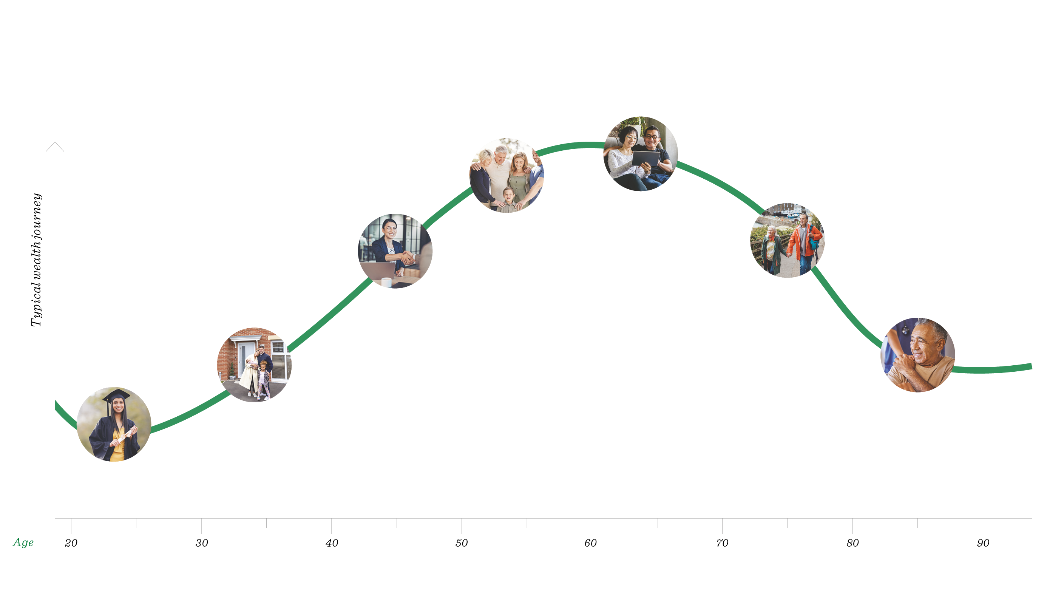
How we can help at every stage of your financial life
Phased retirement
Inheritance planning,
school fees
Promotion, higher salary, receive a windfall
Full retirement, downsizing
Long-term care, bequests
Home purchase,
marriage, children
Student loans, lifestyle needs
Notes:
Remember; it’s never too late but it’s also never too early to start planning for a secure financial future. The same applies to your family, parents, children, grandchildren etc.
A typical financial life journey:
Further Education / Lifestyle
Property Ladder / Mortgage / Raising a family /
Career progression / Salary Increases / Larger Property?
Estate Planning / Savings for children and grandchildren (RETIREMENT PLANNING!)
Retirement options / affordability – phased? Retire & Return (most popular enquiry!)
Full Retirement / Downsizing
Long Term Care

Slide 4


What we’ll give you in this presentation
By the end of this session, you’ll have a better understanding of:
The basics of retirement planning
The essential steps to retirement planning
The avoidable threat to your retirement plan
The value of pensions and the income they produce can fall as well as rise, you may get back less than you invested.
Notes:
Today we will focus on How to build your Retirement Plan:
When can you realistically Retire and what do you want to do? Understanding Expenditure
Your core secure need & lifestyle additions
Your discretionary spend and accelerated timetable ….
Sources of income to support this.
State and Employer pension Schemes – including Partial Retirement
Additional contributions
Other pensions - Partner Incomes as may apply ?
Investment Income.
Part Time working
Understanding the “threats” to your planning (Target market specific)
Inflation – the devil to beat for Income and Capital purchasing power preservation.
Changes to Tax rates and legislation (as appropriate).

Slide 5
The basics of retirement planning

Slide 6

What is retirement planning?
Retirement planning is the financial preparation for life after work
What should you think about?
When to retire
AND How to retire
Why you should do both
You want to make sure your income lasts throughout your entire retirement, whilst thinking about your quality of life.
Notes:
When you want to retire and when you can afford to retire can be very different without proper planning.
We want to help you make your retirement the longest holiday of your life – How long do you spend planning your annual holiday?
Think about your current lifestyle and quality of life: You need to try and make sure your income lasts throughout your entire retirement.
“Well, how do I know how long I’ll be retired?”
Let’s look at who plans for retirement and why and some generic life expectancy data to help clarify and set expectations…

Slide 7



Who plans for retirement and why
Which of these are you?
A young future thinker
I want to lay solid foundations to achieve financial security and flexibility for the years ahead
A mid-career professional
I aim to make the most of
my remaining years in work before retirement
A responsible pre-retiree
I want to be empowered to make informed choices that pave the way for a confident and stable retirement.
The right time to start retirement planning is now – regardless of which life stages best describes you.
Notes:
In simple terms, we are all categorised as one of these ‘types’:
Young future thinkers
Mid-career professionals
Responsible pre-retirees
Everyone here today, regardless of which category you sit in, we’ll all have different ideas and goals for our retirement.
If everyone took advantage of their free initial 1:1 then each of your individual consultations would have a different outcome according to those personal goals and circumstances.

Slide 8

Life expectancy is increasing
Men’s
life expectancy (years)
Women’s
life expectancy (years)
+2.1
+2.2
89.3
87.1
87.2
84.9
2047
2022
2047
2022
Source: ONS
Notes:
Broadly speaking, according to the Office of National Statistics (ONS) we’ll all live until our mid to late eighties, all being well.
That is slowly increasing.
So, if we aim to retire at age 60 our retirement income will likely need to last at least 25 years, maybe longer!
SOURCE: The mortality figures are taken from this report (section 6.5 called ‘Life Expectancy at 65’ which was based on ONS figures that were published in January 2022): https://www.gov.uk/government/calls-for-evidence/second-state-pension-age-review-independent-report-call-for-evidence/second-state-pension-age-review-independent-report-call-for-evidence#trends-in-life-expectancy

Slide 9

Considering your life expectancy
Your average life expectancy is
87 years
The Office for National Statistics have a useful life expectancy calculator.
By simply inputting your age and sex, you can receive key information relevant to you.
For example, a 51-year-old woman will see these results.
However there’s a chance you might live longer…
95 years
99 years
100 years
1 in 4 chance
1 in 10 chance
7.4% chance
Chance of reaching age%
100
87 years
Your life expectancy
67 years
State pension age
75
Why not try it for yourself?
Simply search for ‘ONS life expectancy calculator’ online.
50
25
95 years
99 years
60
70
80
90
100
110
120
Age
Notes:
You could live longer; have a go on the Ons life expectancy calculator!
Simply search for ‘ONS life expectancy calculator’ online.
Even if you retire at age 67, your retirement income may still need to last for 25 years!

Slide 10





Thinking about your income needs
There are three main types of basic income needs:
Core income needs
Discretionary income needs
Health care income needs
“Everyone should be encouraged to think about how their spending patterns may vary over the course of their retirement, including what they may needs to contribute to the cost of care.” Age UK
Notes:
The three main types of basic income needs:
CORE: Money to live on
Bills
Groceries
DISCRETIONARY:
Leisure / Holidays
HEALTH CARE:
Plan for the unexpected / future care needs
SOURCE FOR QUOTE: https://www.ageuk.org.uk/globalassets/age-uk/documents/reports-and-publications/reports-and-briefings/money-matters/fsc_ageuk_financial_resilience_in_later_life.pdf

Slide 11



Types of income needs – trends over a typical retirement
£
£
£
Will your core income needs remain stable?
Will your discretionary income needs start high and then fall?
Will your health care income needs start low and then rise?
Why this is important?
Disability-free life years at age 65 years in England is 9.9 years (ONS).
Notes:
ADVISER NOTE: Click ONCE to populate each graph.
It’s important to understand how your income needs may change over time.
e.g. could you pay off your mortgage and reduce your regular outgoings?
You may increase your leisure / holiday spend in the first years of retirement (remember, it’s the longest holiday of your life!)
Your health care needs may fluctuate and/or increase over time as you get older.
SOURCE: https://www.ageuk.org.uk/globalassets/age-uk/documents/reports-and-publications/later_life_uk_factsheet.pdf
Final bullet point of section 1.2

Slide 12


Building your Retirement Plan
It’s normal for people to feel that their income will be inadequate in retirement…
“If we take a late retirement and an early death, we’ll
just squeak by”
Barbara Smaller
“You can afford to retire at 65 sir, but you’ll need to die
at 70…”
Phil Witte
Notes:
Planning ahead and utilising professional expertise to build a retirement plan will provide peace of mind for you and your family…
ADVISER NOTE: Click & both quotes appears

Slide 13

The benefit of starting now
“My goal is for my investment to be £100,000 in 30 years' time.”
To reach your goal, here’s what you would need to invest each month…
£203
£213
£257
£339
Today
In 1 year
£10 more than if you started today
In 5 years
£54 more than if you started today
In 10 years
£136 more than if
you started today
Figures assume 2% net growth rate after charges
Source: https://www.moneysavingexpert.com/savings/regular-savings-calculator/
Notes:
SOURCE: These figures were calculated by Quilter for demonstration purposes, assuming 2% net growth rate after charges using Money Saving Expert savings calculator as a guide: https://www.moneysavingexpert.com/savings/regular-savings-calculator/

Slide 14






Why do you want to plan for retirement?
What’s your ‘why’? Here’s what lots of our customers say
I want…
Financial security.
Freedom and flexibility.
To maintain the lifestyle I’m used to.
I want to avoid…
Becoming a financial burden on others.
I’m hoping to…
Live happily in retirement.
Have a long retirement and have the money to cover it.
Notes:
In reality most people don’t know where to start and that’s ok. You have already taken the first step by being here today…
You might feel aligned to some of our customers comments here.
It seems an obvious thing to say, but when you stop working, guess what? They stop paying you. That’s why it’s so important to put a plan in place.

Slide 15
The essential steps to retirement planning
Notes:
So, let’s look at how to simplify your retirement planning….

Slide 16




Your 4 essential steps to retirement planning
1. Establish your retirement goals
2. Work out how much money you’ll need
3. Assess your income options
4. Consider tax implications
Notes:
In simple terms you should break your planning down into four key areas…

Slide 17


Starting from the start
Retirement means different things to different people.
Notes:
We’re all different; everyone here today will be at different points of their careers, different pension contribution levels, differing natural retirement age as well as different ideas and objectives for our futures.
Ultimately it still comes down to making your retirement one long holiday and that’s where our expertise comes into its own in helping you to shape a financial plan.
So, in terms of creating a plan let’s drill-down into each individual area, looking at steps 1 to 4…

Slide 18



Step 1 - Establish your retirement goals
Retirement means different things to different people.
It’s important to start by defining what it means for you. Ask yourself:
What does my ideal retirement lifestyle look like?
What are my financial objectives?
When should I start saving and planning?
Notes:
As I just alluded to, retirement means different things to different people for a variety of reasons…

Slide 19






Step 2 – Work out how much money you will need
You must be honest about how much you think your future spending will be.
Ask yourself:
What is the minimum income I will need to cover my outgoings?
How much would I like to be able to spend on non-essentials?
Am I entitled to state benefits?
How much are my savings, or can I save towards retirement?
Notes:
Be honest about how much you think your future spending will be; be honest with your adviser but also be honest with yourself.

Slide 20




Step 3 – Assess your income options
Your income can come from different places.
Planning wisely involves figuring out how to use these options together. Ask yourself:
How much money can I afford
to lose?
Do I have emergency funds to provide unexpected expenses?
Notes:
Remember, when you stop working they stop paying you so you need to assess your options.

Slide 21






Different places your income could come from
Pensions - Which do you have?
State pension
Private pension(s)
Workplace pension(s)
Other sources - Which do you have?
Savings and investments
Financial support
Property
Notes:
State Pension – a regular payment from Government
Workplace or private pensions – You and your employer save monthly for regular payments when you retire
Savings and investments – Funds you’ve set aside and can use gradually during retirement
Property – rental income from any property you own, the funds raised from selling a property, or selling some of the equity in your home
Bear in mind that releasing equity from your property will reduce the value of your estate. It can also affect whether you are eligible for any means tested benefits that you might want to apply for in the future.
Financial support – You may also receive financial support through benefits like Pensions Credit or Carer’s Allowance.

Slide 22


Your state pension – how much could you get?
You paid in
You get out
The full state pension increased to £230.25 per wk for 2025/26
(4.1% increase)
£11,973 per year
Your National Insurance Contributions
Your Basic State Pension
Why not find out your entitlement today?
Simply go to ‘www.gov.uk/check-state-pension’ online.
You can also find out by telephone on 0800 731 0175
Or request ‘BR19’ to receive your entitlement in writing.
Notes:
Important! You may have an option (or preference or need) to retire before you qualify for the state pension.
State Pension provides a basic income (currently c.£11,900pa).
UK state pension rise effective from 6th April was +4.1% due to inflation.
Source: https://www.gov.uk/government/publications/benefit-and-pension-rates-2025-to-2026

Slide 23




Do you have old pensions?
You may have accrued benefits with former employers or individual personal arrangements.
These old pensions do not die, so they should still have a value and can be traced. These may be from:
Former employers from private or public sectors.
Additional contributions e.g. AVC or FSAVC.
An individual pension e.g. a Personal or Stakeholder Pension.
And don’t forget your partner’s past pension history.
Notes:
An important point to note is that ‘Old Pensions Never Die’… do you or your partner have previous employment during which you contributed to a pension. It’s possible you may have lost track of these if you have moved home and inadvertently missed companies off of the update list!
(these type of communications are easily forgotten but your money is sitting somewhere waiting for you!)

Slide 24


Step 4 – Consider tax implications
Your different sources of income are most likely to be subject to tax.
Thinking about this and planning for tax will help maximise your finances during your retirement years. Ask yourself:
How much tax might I have to pay on my retirement income?
How much money can I take out of my pension without paying extra tax?
Tax treatment varies according to individual circumstances and is subject to change.
Tax Planning is not regulated by the Financial Conduct Authority

Slide 25
Summary - Your 4 essential steps to retirement planning
1. Establish your retirement goals
2. Work out how much money you’ll need
3. Assess your income options
4. Consider tax implications
Notes:
So we’ve covered, at a very high level a simplistic four essential steps to shape your retirement plan

Slide 26
The key threat to your retirement plan
Notes:
So far, we’ve covered the basics of retirement planning and now we’ll drill down into a bit more detail of things you need to be aware of and the benefits of taking advantage of your free initial 1:1 and getting a professional view.

Slide 27
Four types of money
Emergency
To cover Core expenditure for period of 3 - 6 months
Kept in Bank/Building Society
Immediate Access
Short term
  1- 5 years
  E.g. savings for house deposit or making major purchase
  Short term access or notice period
Medium term
  6 - 10 years
  Inflation +
  Longer term aims/goals
Long Term
  10 years plus
  Inflation +
  Longer term aims/goals
  E.g. provision for retirement
Notes:
A useful tip is to create and maintain four categories of money; each category is managed slightly differently as it is designed to serve different purposes.

Slide 28






Inflation; the enemy
A sustained increase over time in the overall prices of goods and services in an economy.
Usually expressed as a percentage (%) that shows the rate at which prices increase over time.
What does this mean for your retirement?
Inflation means that with the same amount of money, you will be able to afford less in the future. As a result, the higher rate of inflation, the less you’ll be able to afford.
Inflation is taxation without legislation
Milton Friedman
Notes:
Earlier we established that ‘the longest holiday of your life’ (retirement) could, all being well, last 20 years or longer.
It’s important to be aware of the impacts of inflation because the income you retire on will continue to be impacted.

Slide 29
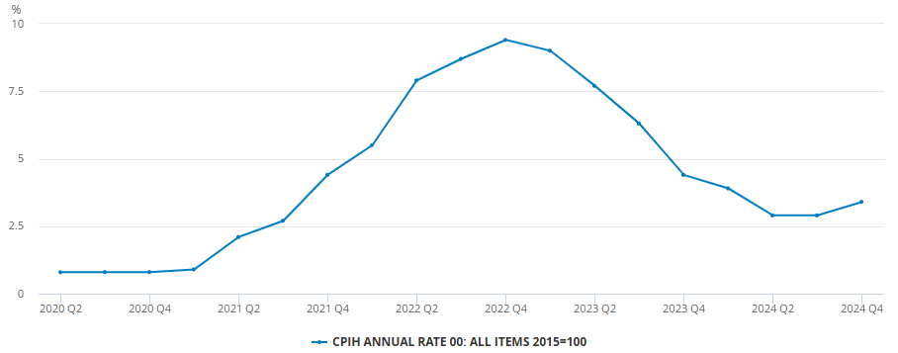
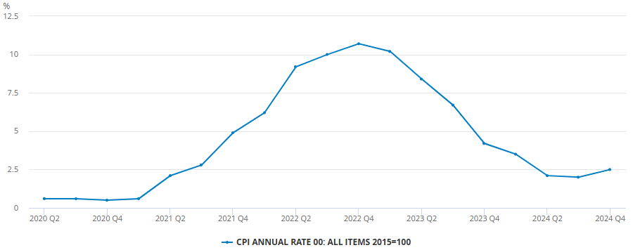
Inflation in the UK
We’ve seen sharp rises in inflation in the UK in the past few years, especially during 2021-2022.
Inflation can change a lot, meaning that it’s important to protect the value of your money and secure your financial future.
Consumer Price Index
Below is the Consumer price index, showing the percentage annual change in the price of typical goods that you might buy every day.
Source: ONS, CPI annual inflation 20/03/24
Notes:
The annual rate of inflation reached 11.1% in October 2022, a 41-year high. As a result, consumer prices, as measured by the Consumer Prices Index (CPI), were 10.5% higher in December 2022 than a year before.
Key drivers of inflation rises are increases in the costs of consumer goods, food prices, energy prices and road fuel costs.
Highlight that if cash in the bank does not go up by more than the rate of inflation then in real terms it is worth less than it was when it was invested.
If losing money is an investment risk, then having your money eroded away by inflation is a risk
Graph source: ONS, CPI annual inflation rate, series D7G7 (26 March 2025)
https://www.ons.gov.uk/economy/inflationandpriceindices/timeseries/d7g7/mm23

Slide 30
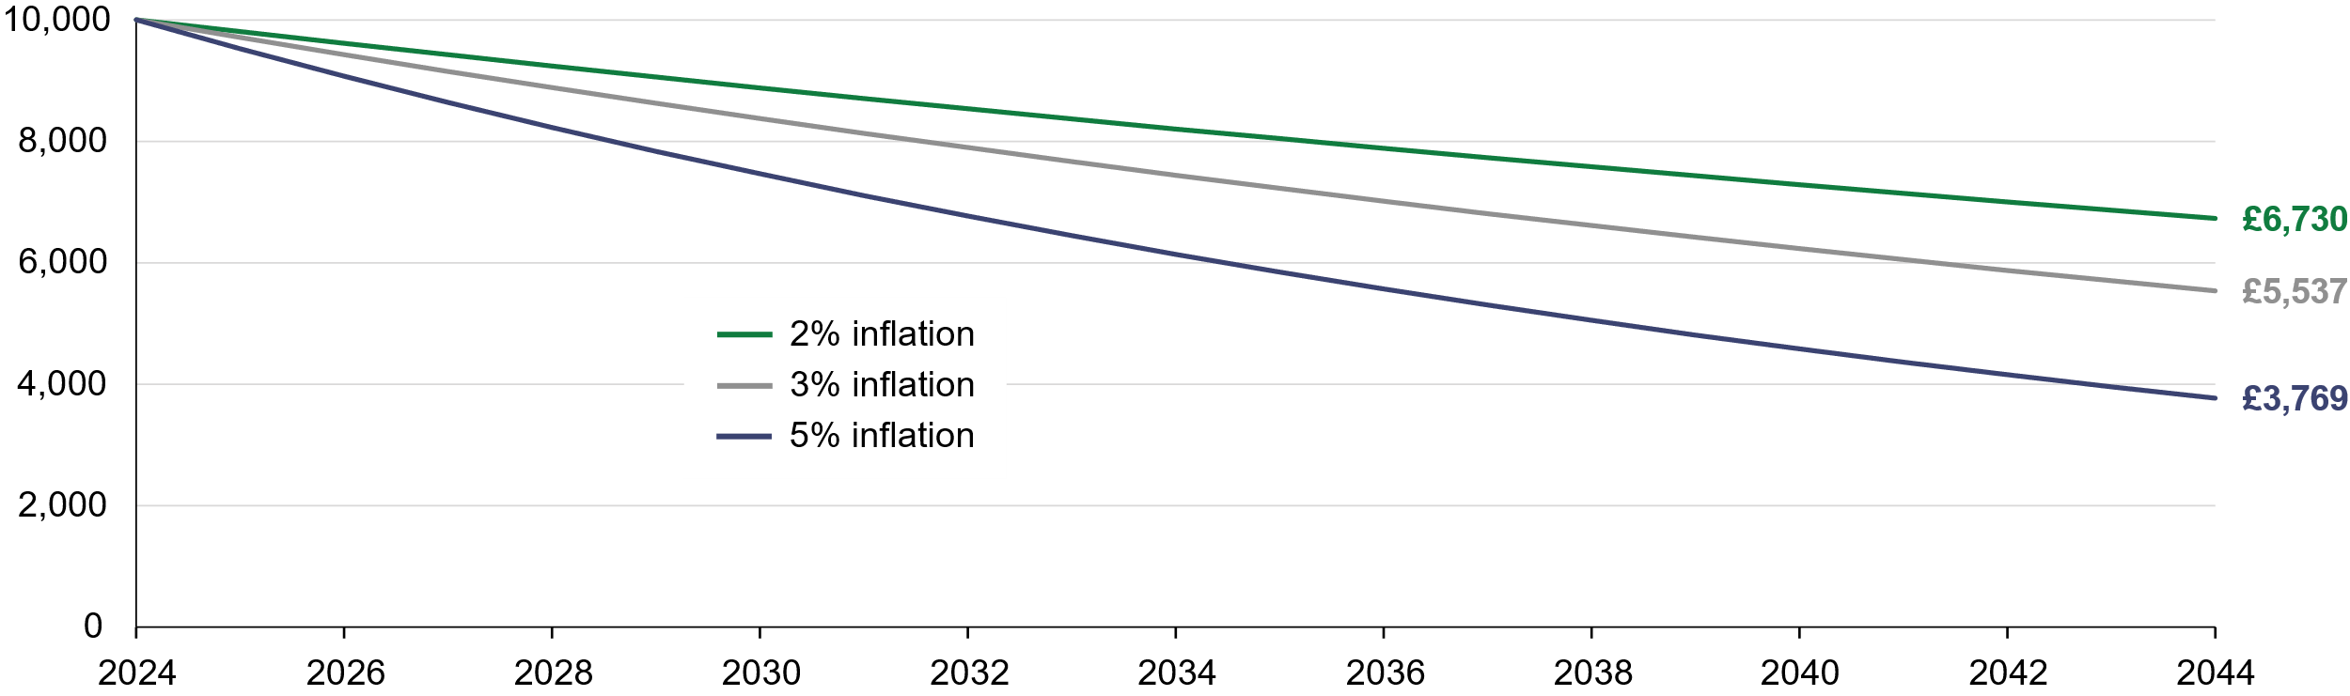
The real effect on your money
The higher the rate of inflation the less your money in the bank can buy.
The higher the inflation rate, the less the same amount of money can buy in the future.
The effect of inflation on £10,000 cash over 20 years
Returns (£)
Source: Quilter Investors as at 30 June 2022. The information is provided for demonstrative purposes and does not represent the past performance of any particular investment
Notes:
This graph shows a projected effect of inflation over the next 20 years; we’ve used three rates as examples, but the reality could be different (consider where inflation was 12 months ago)
Think about this in reverse; for example, a basic Ford Fiesta cost c.£9k in 2004; 10 years later, when you could still buy a new Fiesta, a basic model was c.£19k
As a side note, the original Ford Fiesta launched in 1977 and cost c.£1,900!!
It’s worth noting that all of this is relative to wages; 1977 average salary was £3,500 and average house prices were c.£12k.
By 2004 the average home cost c.£100k.
SOURCE: https://www.parkers.co.uk/used-cars/history-of-the-ford-fiesta/

Slide 31
How inflation reduces the value of your cash holdings
There can be large differences between interest rates and inflation.
In recent times, we’ve seen this gap grow to the largest it’s been for more than a decade.
-9.42%
-5.31%
-2.78%
-2.81%
Source: Cash ISA rate (monthly interest rate of UK monetary financial institutions sterling cash ISA deposits including unconditional bonuses), Bank of England Database, 10 April 2025 and UK CPI, ONS, 26 March 2025.
Notes:
In response to higher inflation, the Bank of England’s Monetary Policy Committee (MPC) raises interest rates to lower inflation by raising the cost of borrowing. In turn, as people and businesses have less money to spend on other things and more incentives to save, demand for goods and services in the economy is diminished. Lower demand reduces the pressure on firms to raise prices.

Slide 32
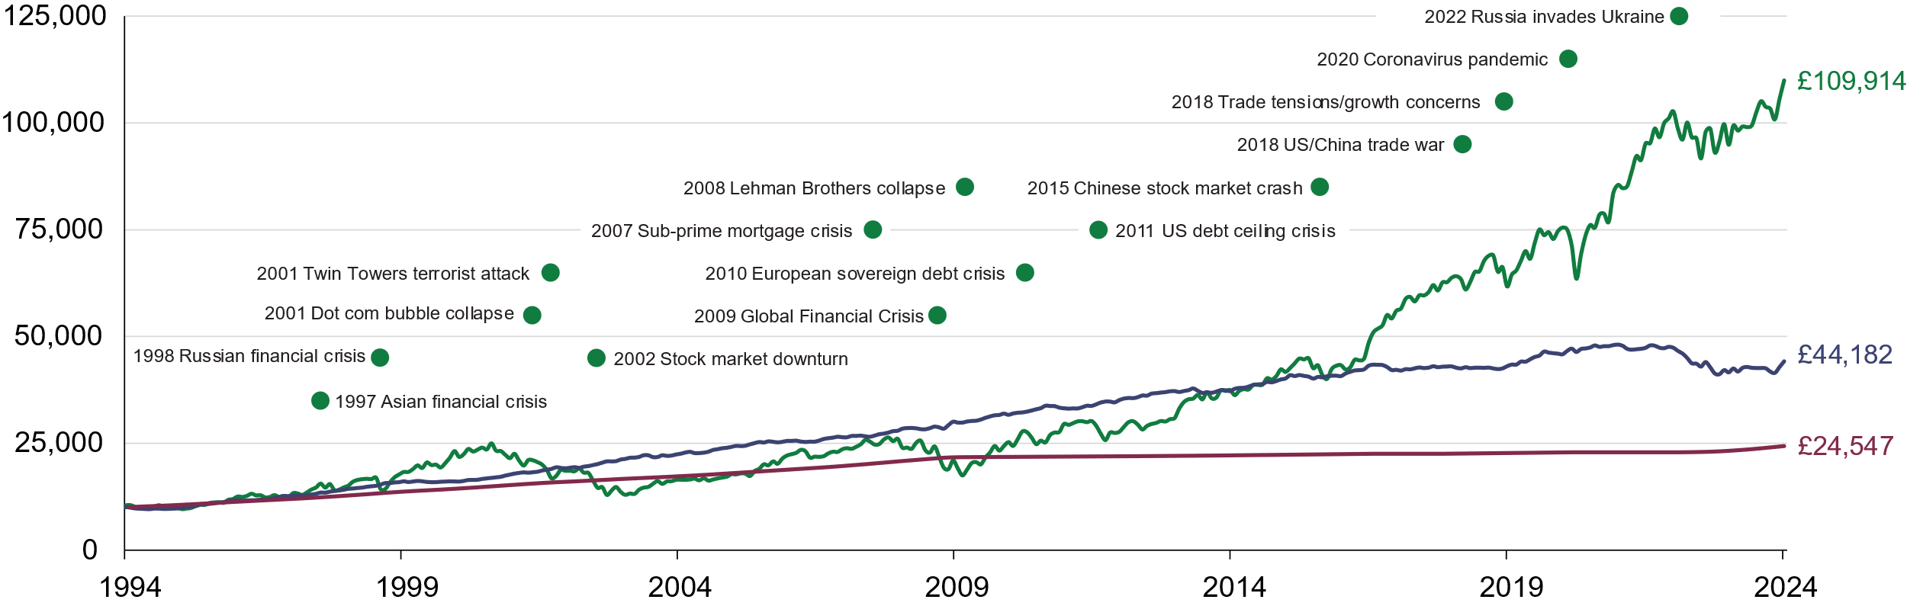
It’s important to invest for the long term
Investing as soon as you can with a long-term outlook will protect the value of your money against changes in the economy and stock markets.
Changes in the political landscape and economic conditions can significantly influence your money.
Global Equities
Returns (£)
Global Bonds
Cash
Source: Quilter Investors Investing Through Volatile Times
Notes:
Some key moments highlighted in the graph:
1992 ‘Black Wednesday’ Stock Market Crash / 2001 Twin Towers attack / 2002 Stock Market downturn / 2008 Lehman Brothers collapse / Global Financial Crisis / 2015 Chinese Stock Market crash / 2020 Coronavirus Global Pandemic / 2022 Russia Invades Ukraine
Key Takeaways:
Don’t let short term blips distract you from your long-term plans
Investing over the longer term (i.e. 5 years or more) is more likely to be successful
People who stay invested are more likely to see their investments recover
Source: Quilter investors Investing Through Volatile Times
https://www.quilter.com/siteassets/documents/quilter-investors/corporate/investing-through-volatile-times.pdf

Slide 33
What long-term investment could look like for you
Based on the previous graph, an investment of £10,000 in global equities would have grown by 1000% over an investment period of 30 years.
Initial investment
£10,000
+1000%
Investment value after 30 years
£110,000
The value of investments and the income they produce can fall as well as rise.
You may get back less than you invested.
Past performance should not be regarded as a guide to future performance.
Notes:
These figures are for demonstration purposes only. Any personal recommendation regarding investing would take into account an individual's attitude to risk and capacity for loss.

Slide 34
Protect your wealth with professional advice

Slide 35

Considering the tax rate payable “in retirement” is now ever more critical
Pension Commencement Lump Sum (PCLS)
Frozen at £268,275 in cash terms
The “anchoring" of tax-free cash – 25%
Its value will be reduced by continued stubborn inflation
  How much will £268,275 be worth one year from now in real terms?
  And 5 years from now? 10 years?
Any excess beyond the new maxima will be taxable at highest marginal rate
Notes:
You may or may not be impacted by these rules, depending on your personal circumstances.
Pension Commencement Lump Sum (PCLS) is fixed at 25% of the old LTA figure ( £1,073,100 x25% = £268,275) for the foreseeable future.
Inflation will erode the real purchasing power of these funds,

Slide 36


The new landscape now asks us more challenging questions
For people with substantial pension assets, should they fully crystallise?
Provides certainty for individuals who would have otherwise been subject to an LTA charge – ensure that no excess lump sum is generated
If 100% LTA used, no downside
If they are at PCLS maxima – any excess is taxable at their
marginal rate when benefits are taken as income
Need to consider re-enveloping of PCLS
Also consider wider IHT position – impact on intergenerational plan
Notes:
Remind PCLS = Pension Commencement Lump Sum
In essence, the value of your PCLS will reduce in real terms due to the effect of inflation (as explained in the earlier inflation slides)
If you are going to take up the full PCLS (and give up valuable I/Linked pension to do so!) then you either need to spend them quickly or invest them wisely. If that is the case then we can help. Taking advantage of your free initial 1:1 can provide you with comfort that you are making the right decisions and one of our advisers will explain it in real terms in the light of your own personal circumstances.

Slide 37

Financial product management is needed to protect your wealth
Flexible
ISA
Junior pension
General
Investment
Account
JISA
Onshore
Insurance Bond
Personal pension
You may need more than one financial product to best ‘re-envelope’ PCLS
Notes:
Remind PCLS = Pension Commencement Lump Sum
By talking to a financial adviser you will benefit from personalised recommendations to suit your own circumstances.

Slide 38
Talk to a
financial adviser
Notes:
So, what next?

Slide 39

What we’ve given you in this presentation
You now have a better understanding of:
The basics of retirement planning
The essential steps to retirement planning
The avoidable threat to your retirement plan
The value of pensions and the income they produce can fall as well as rise, you may get back less than you invested.
Notes:
So, next there will be a test of what you have learned today! I’m only joking, there is no test but I hope this has been helpful.
I have to reiterate again that this information is generic and should not be regarded as ‘advice’ and I do hope it has reinforced the value of seeking professional advice.
In summary, we have covered:
How to build your Retirement Plan When can you realistically Retire and what do you want to do
Understanding Expenditure
Your core secure need & lifestyle additions
Your discretionary spend
2. Sources of income to support this.
State and Employer pension Schemes – including Partial Retirement
Additional contributions
Other pensions - Partner Incomes as may apply ?
Investment Income.
Part Time working
4. Understanding the “threats” to your planning
• Inflation – the devil to beat for Income and Capital purchasing power preservation.
• Unable to work due to Illness – Cashflow models on Tier 1 and Tier 2 benefits in play and showing limitation of Employer protection.
• Dying before retirement – the impact upon your planning. Simple Illustrative cash Flow modelling again, adding in Employer pension Scheme benefits.

Slide 40




Your top tips to build your retirement wealth
There are several actions that you can start taking now to build your wealth in the future for the retirement you want.
Plan
Invest
Optimise
Speak to a financial adviser
Review your plans
Start saving now
Save consistently in the future
Diversify your investments
Consider high risk investments when you start out to maximise your returns
Explore your pension options for the best deal
Maximise your retirement benefits
Take advantage of tax benefits
Notes:
So, what next?
If you visit my adviser profile on quilter.com you can submit a form to contact me and book a free initial financial consultation.
Just google quilter.com/ADVISER-NAME

Slide 41



Contact me today
SCAN ME
Insert QR code
Adviser to add a QR code directing to their quilter.com profile or delete this slide
Notes:
Or you can scan the QR code on the screen now which will direct you to my adviser profile on quilter.com, where you can request an initial consultation.

Slide 42
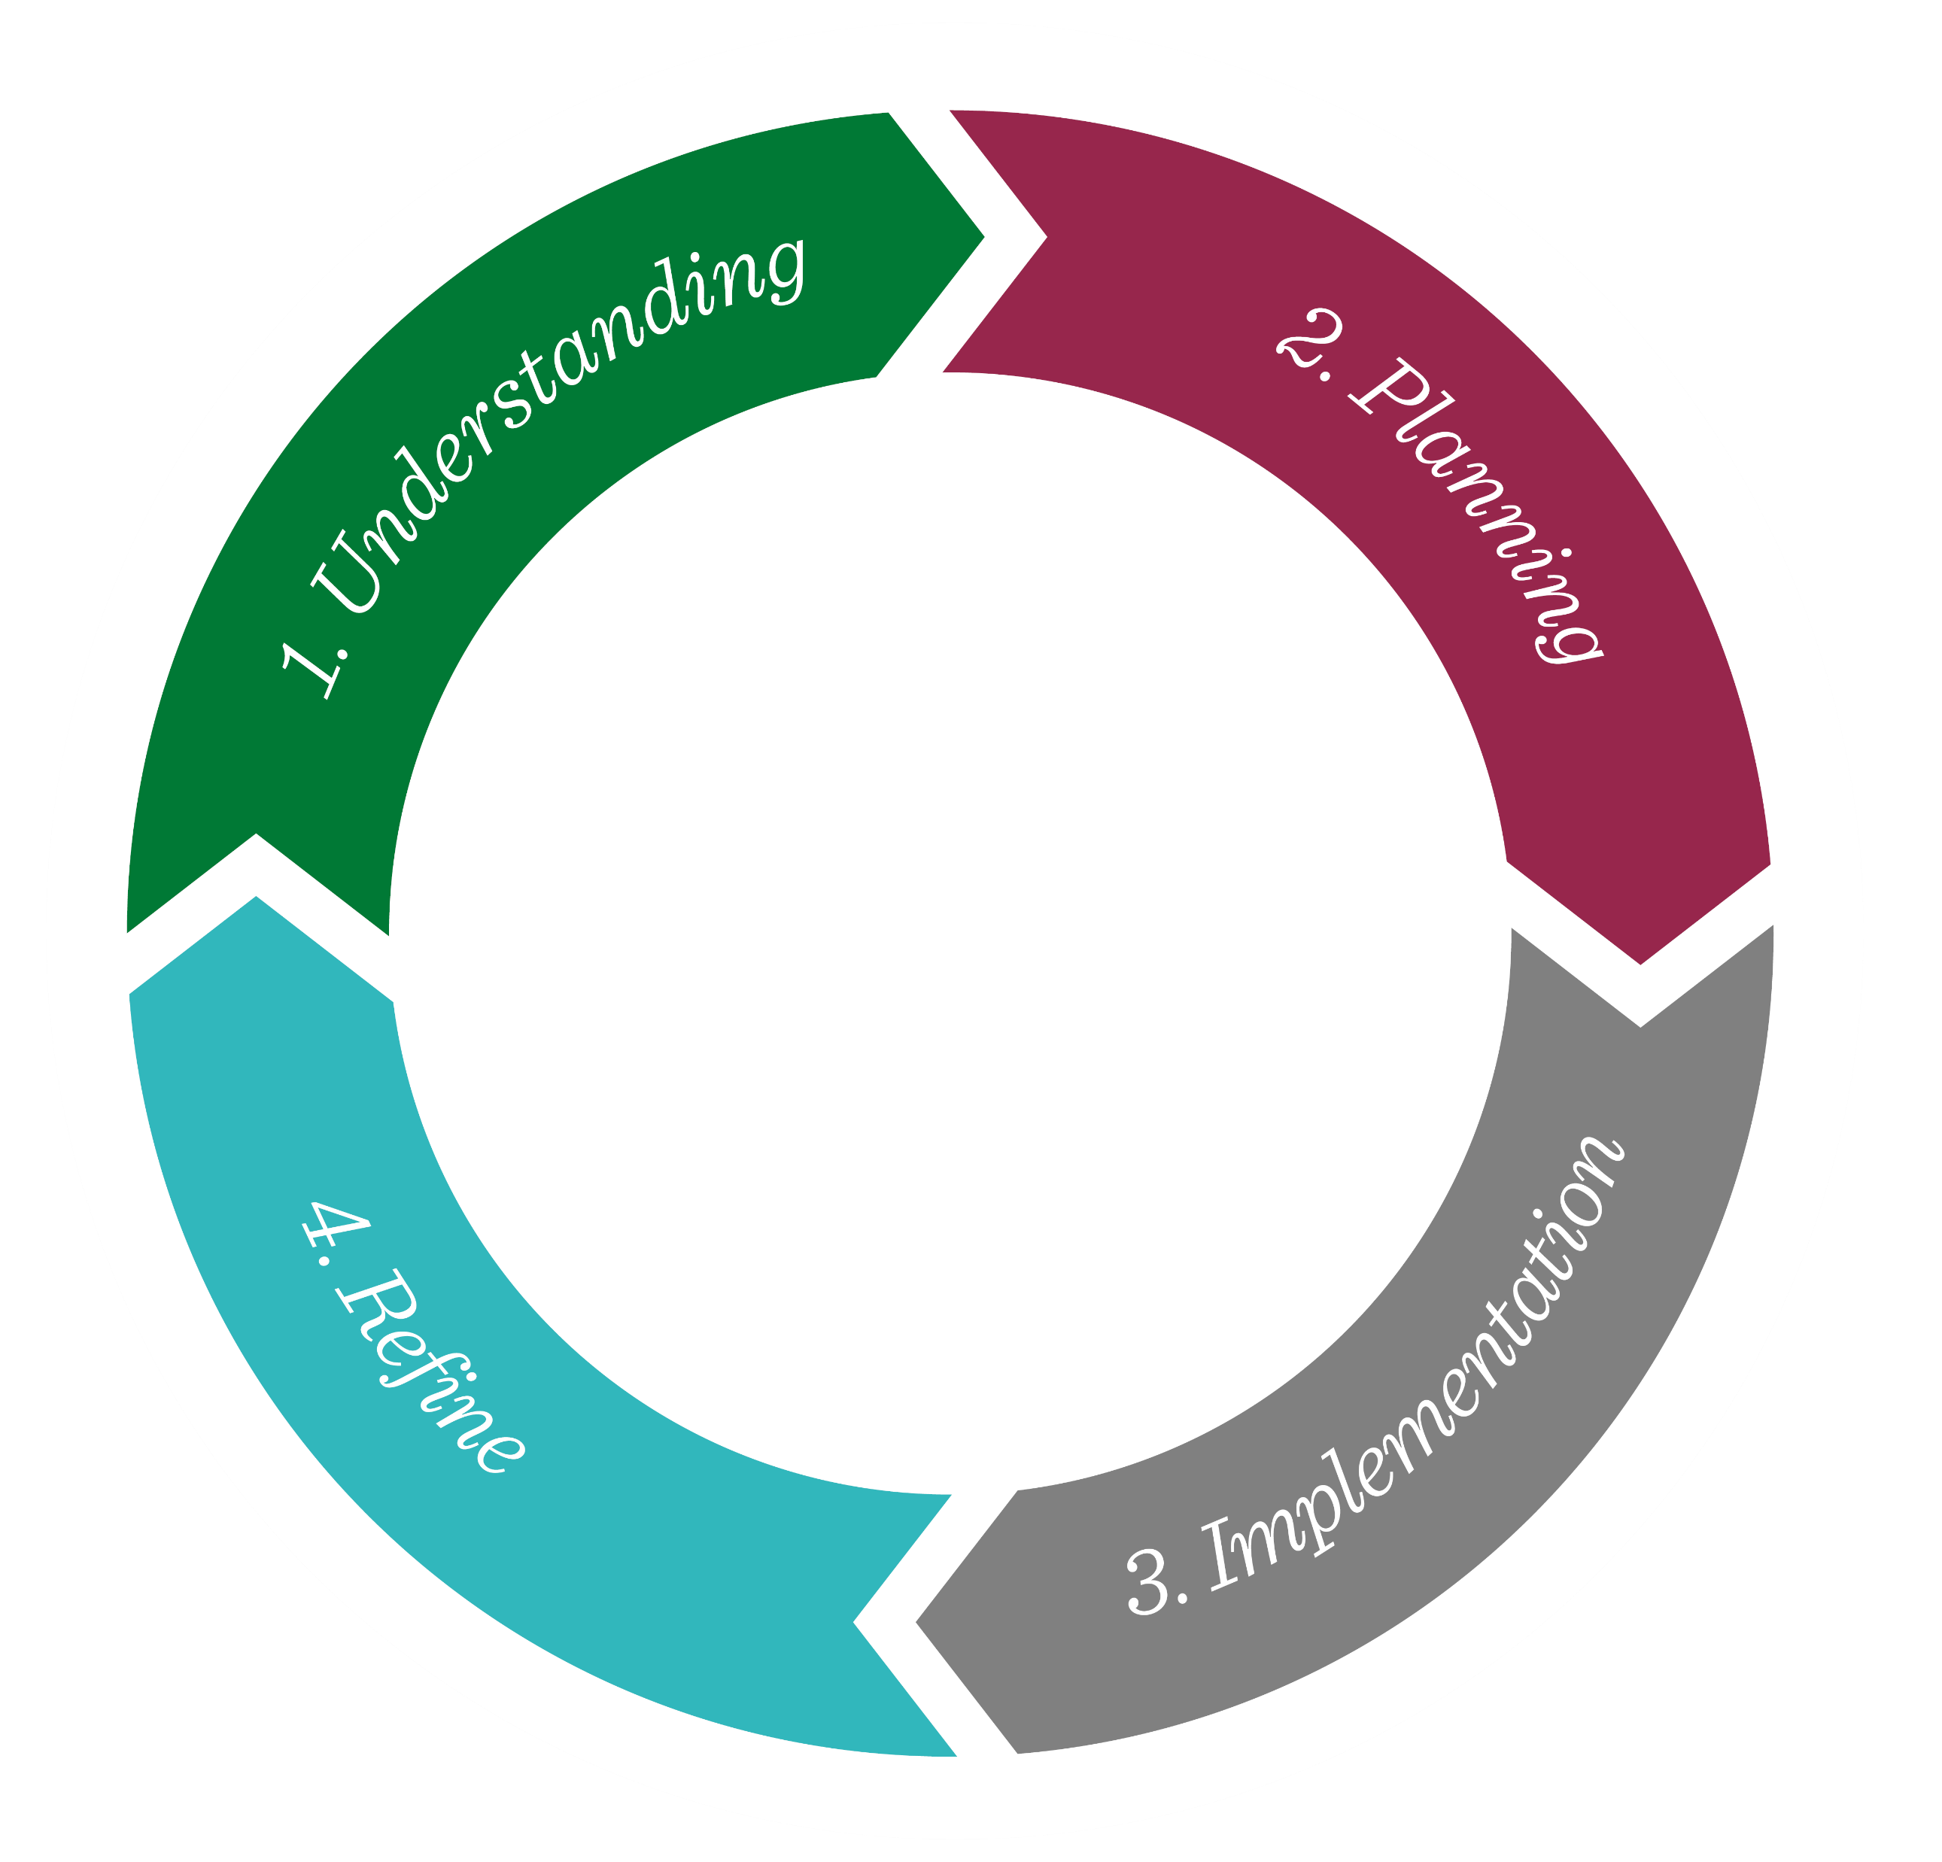
Our advice process is all about you
You’re at the centre
This is the process we
follow to make sure you get the quality of advice you need.
Notes:
At Quilter Financial Advisers, we take each client through a tried and tested advice journey which allows us to fully:
Understand you and your requirements,
To use our expertise to plan a tailored solution
To help implement the strategy so it has the desired outcome to achieve your objectives
And to review the plan regularly to ensure it remains fit for purpose.

Slide 44
Thank you
Please remember:
The information we have provided at this seminar is generic and not to be taken as personal advice. Please contact one of our professional financial advisers in order that we may arrange a personal consultation, without obligation, to discuss your individual circumstances.
The value of pensions & investments and the income they produce can fall as well as rise. You may get back less than you invested.
Quilter Financial Advisers recommend the most suitable financial products for you.
Whilst every effort has been made to show the information accurately, Quilter Financial Advisers and affiliated companies cannot be held liable, for any errors or omissions, or for any financial losses, costs, expenses, or other adverse consequences encountered as a result of any reliance placed on information contained therein.
Terms and Conditions. Following the initial consultation, if you wish to appoint Quilter Financial Advisers
as your financial adviser we will explain and agree any charges with you before undertaking any work
on your behalf.

